Slide 1




Health and Fitness Tracker
A PYTHON-BASED PROJECT FOR MANAGING HEALTH GOALS
START SLIDE
SLIDE
01

Slide 2
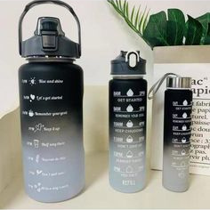

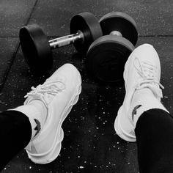

Introduction
01
The Health and Fitness Tracker is a Python-based project
It enables users to monitor their health activities like steps walked, calories burned, and water intake
02
02
03
Provides insights into daily, weekly, or monthly progress
03
Designed to promote healthier habits through simple logging and visualization
04
SLIDE
02

Slide 3


applications
01
Helps users set and monitor health goals
02
Encourages a structured and healthier lifestyle
01
Suitable for personal use, gym enthusiasts, or fitness coaches
03
04
Can be extended into mobile apps for on-the-go tracking
05
Provides personalized insights to improve health outcomes
03
SLIDE

Slide 4
Titles of the Project
01.
02.
03.
User Registration/Login
Input daily activities
Store data
04.
05.
Option to log out or continue
Generate and display progress reports
SLIDE
04

Slide 5
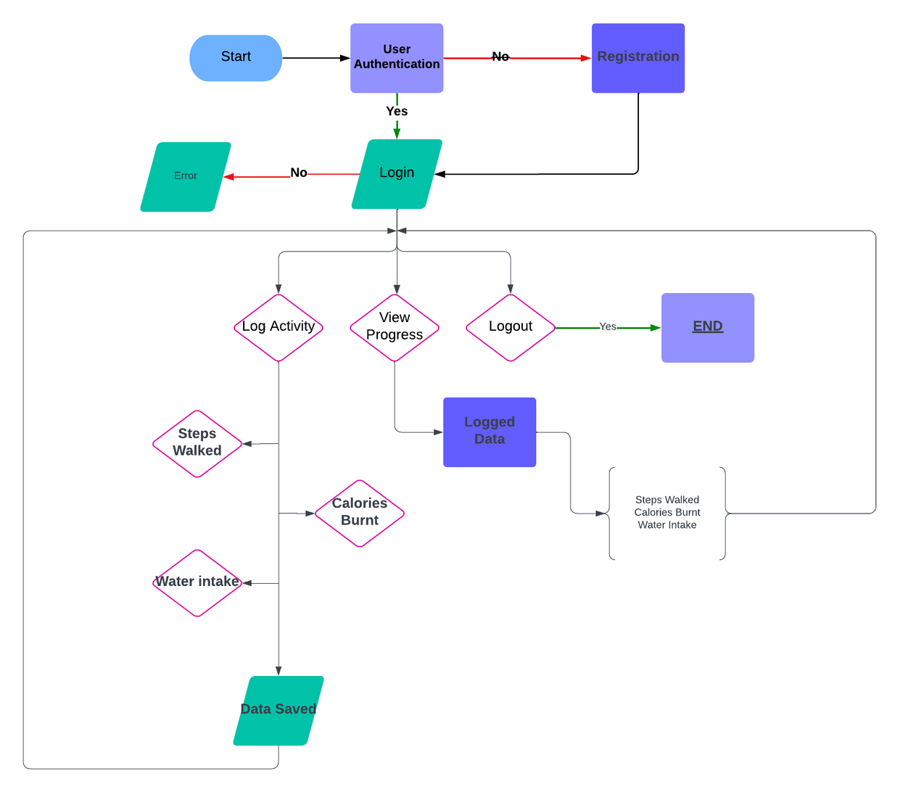
Flowchart of the Project
01.
SLIDE
05

Slide 6
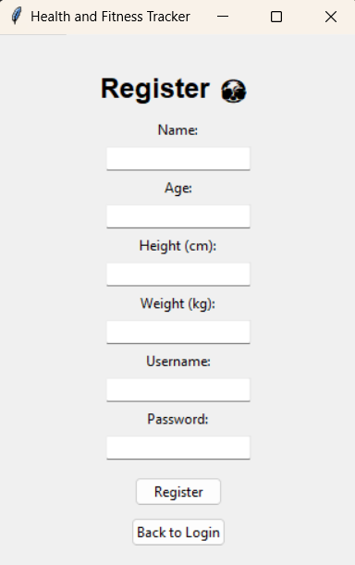
User registration
User is registered by Entering the below data
Name
Age
Height and weight
Username And Password
Prevents unauthorized access through password protection
SLIDE
06

Slide 7
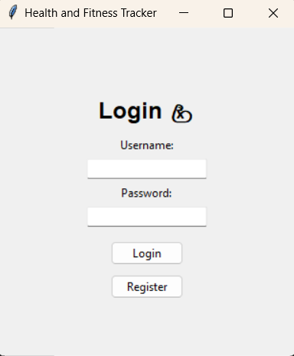
User Login
Users log in using their username and password
The program validates credentials against the stored JSON file
If credentials are valid, access is granted
If invalid, the user is prompted to retry
SLIDE
07

Slide 8
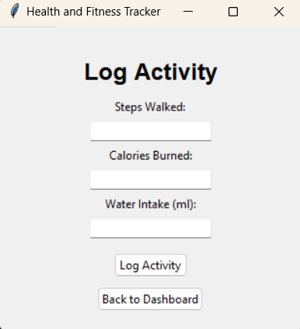
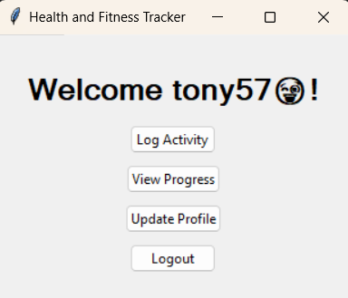
Logging Daily Activities
The user inputs :
Steps walked
Calories burned
Water intake in milliliters
Tracks daily fitness activities
Enables progress analysis over time
SLIDE
08

Slide 9
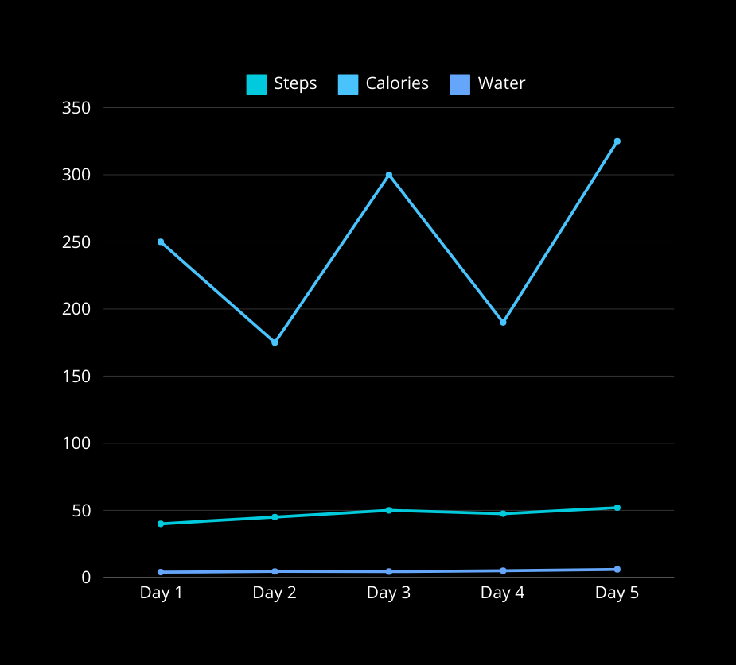
Viewing Progress
Users can view their logged data as:
Daily summaries
Graphical representations (using matplotlib)
Allows users to analyze and adjust their fitness routine
SLIDE
09

Slide 10
Data Storage
{"john_doe": {"password": "hashed_password","profile": {"logs": {"2024-11-17": {"steps": 5000,"calories": 300,"water": 2000}}}}}
All user data, including activity logs, is stored in a structured JSON file
New entries are appended to the file without overwriting existing data
Ensures persistent and easily accessible data storage
SLIDE
10

Slide 11

Logout
Users can securely exit their session after completing their activities
Ensures privacy and protection of data
Ends the current session and prepares the application for the next user
SLIDE
11

Slide 12
Conclusion and Future Scope
01.
02.
Conclusion
Future Scope
The Health and Fitness Tracker simplifies health goal monitoring
Add database support (e.g., SQLite for scalability)
Introduce mobile app compatibility.
Promotes consistency and provides valuable insights for improvement
03.
Drawbacks
Limited storage and analytics capability with JSON
No integration with external APIs or wearables
SLIDE
12

Slide 13

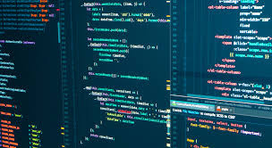
References
Python Documentation: https://www.python.org/doc/
JSON Module: https://docs.python.org/3/library/json.html
Matplotlib Library: https://matplotlib.org/stable/contents.html
Python Tutorials: https://www.w3schools.com/python/
Visual Flowchart Tools: https://lucidchart.com
SLIDE
13

Slide 14
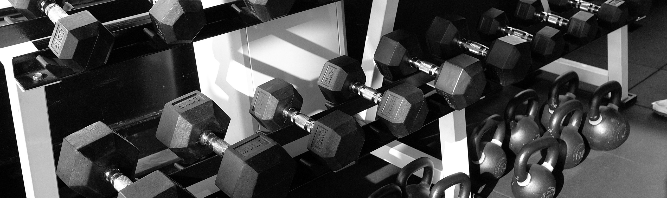
Thank You
SLIDE
14

